Slide 1

H16W 35 – Relational Database Management Systems
Entity Relationship Diagrams

Slide 2
Reminder…
Entities are Similar to Classes in OOP
Used in the Conceptual model
Based on THIRD Normal Form design
Becomes a TABLE in the Physical Model

Slide 3
Attributes
Attributes are listed inside entities (based on 3NF)
They also detail:
Primary Key status
Foreign Key status
Data Type
Data Type Sizes
Mandatory / Nullable
This will be obtained from the Data Dictionary

Slide 4
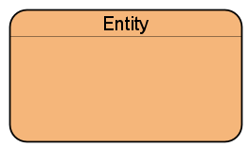
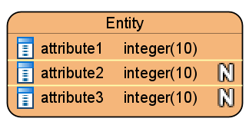
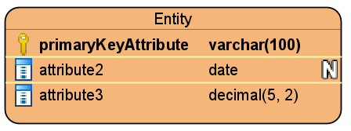
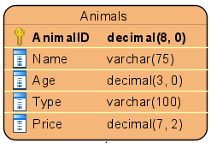
Drawing Conventions
An entity is drawn in a box…
Entity name at the top
Attributes inside the box
Data types
Primary + Foreign keys
Etc.

Slide 5

Entity Relationships
For the purposes of the exercises and assessment you will only need to use one relationship type:
“One to Many”

Slide 6
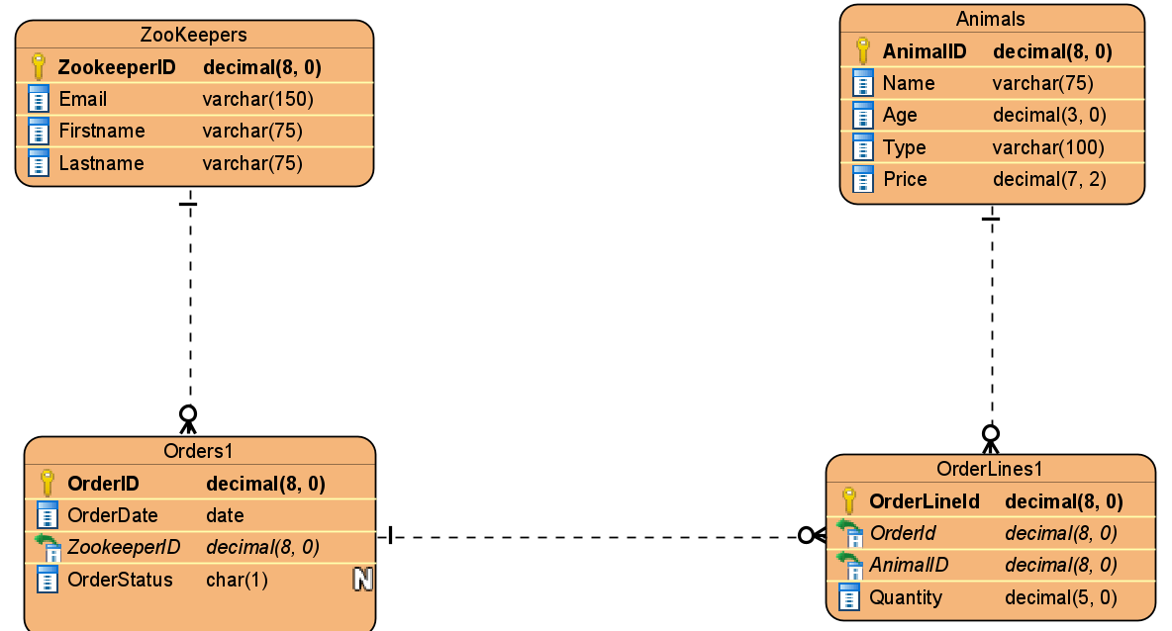
Example ERD

Slide 7
Relationship Drawing
It can be difficult deciding which relationships connect to each other
Almost all relationships are One to Many relationships
All the ones in the exercises and assessments for this unit will be
But it can be though to determine which Entity gets the “many” end in a relationship
Fortunately there are some handy rules to follow which will see you right

Slide 8
Relationship Drawing Rules
Rule number 1 – Determining which entities have relationships
Examine all the entities with single attribute primary keys
If you see another entity with a column the same name as the primary key…
Then you draw a one to many relationship between them
Rule number 2 – Determining which side gets the “many” end (part 1)
If you have a relationship between an entity with a primary key and an entity with a composite key then
The composite key entity always has the many end

Slide 9
Relationship Drawing Rules
Rule number 3 – Determining which side gets the “many” end (part 2)
Alternatively,
If you have a relationship between an entity with a primary key and an entity with a foreign key then
The foreign key entity always has the many end
Rule number 4 – Just in case…
Never draw a relationship between a composite key entity and a foreign key entity (even if they have the same column name)
Rule 1 tells you not to do this!

Slide 10
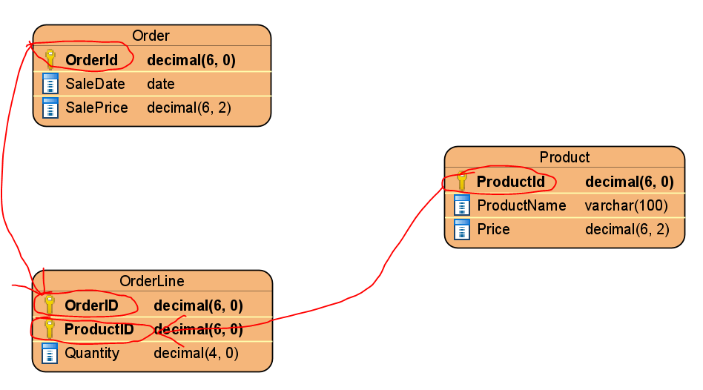
Rule 1 - Examples

Slide 11
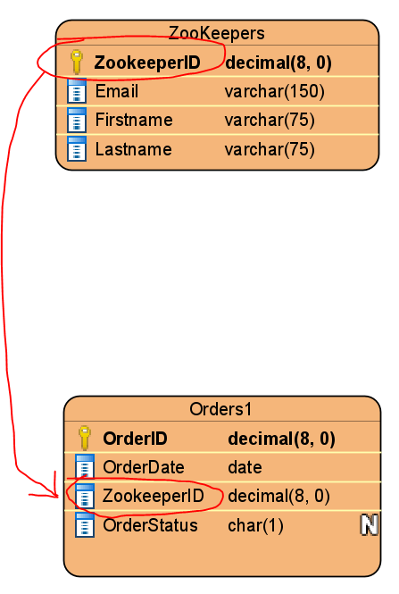
Rule 1 - Examples

Slide 12
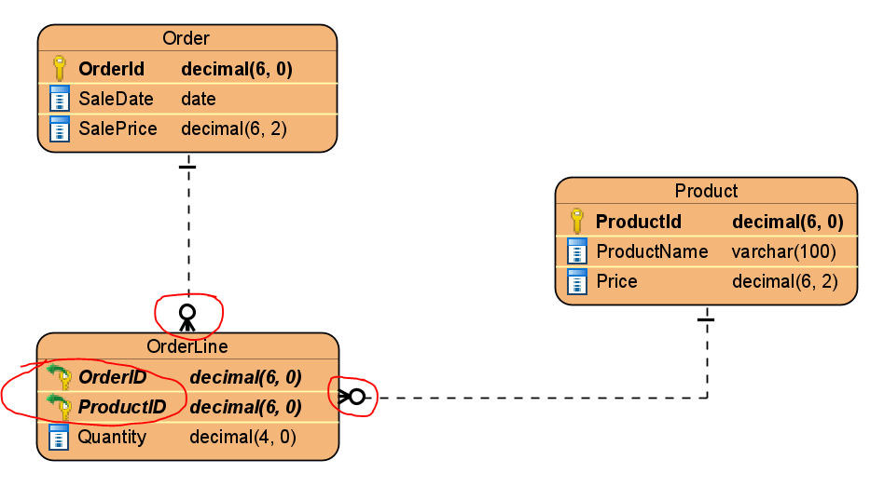
Rule 2 - Examples

Slide 13
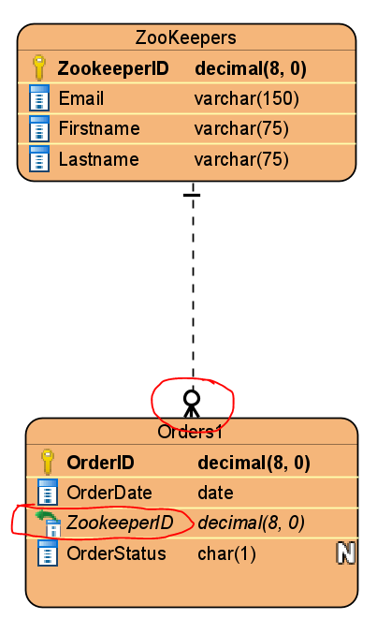
Rule 3 - Examples

Slide 14
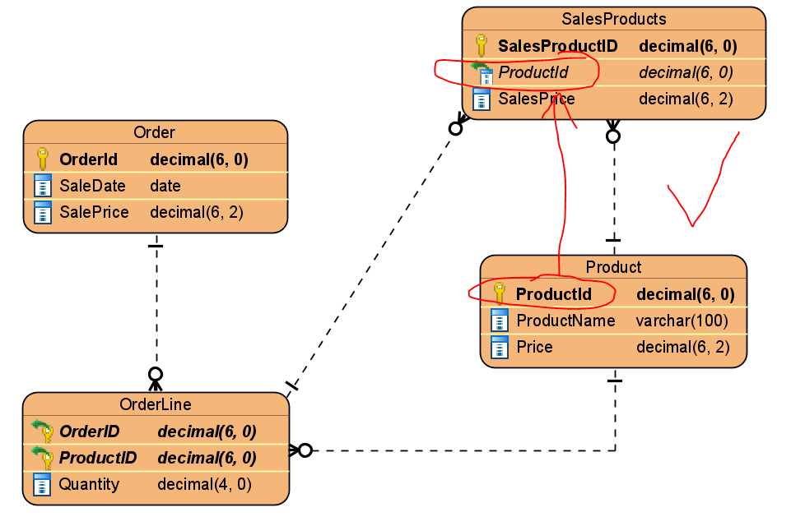
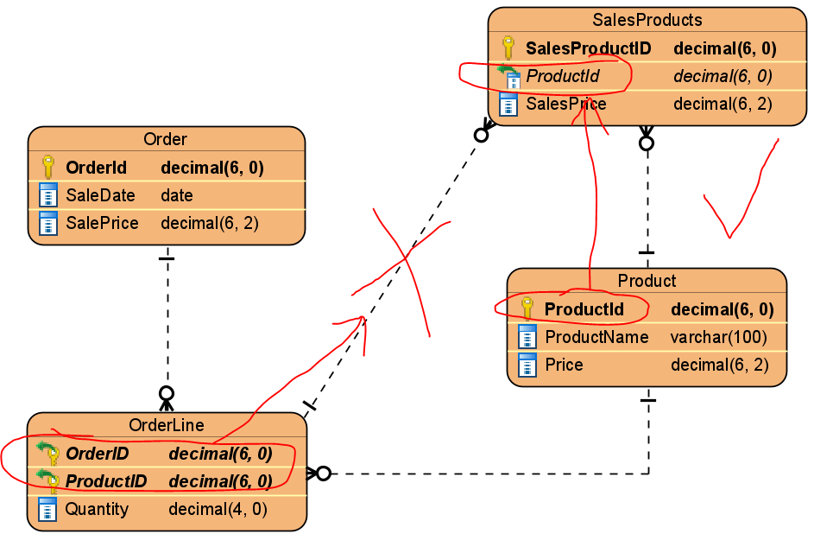
Rule 4 - Examples

